Slide 1
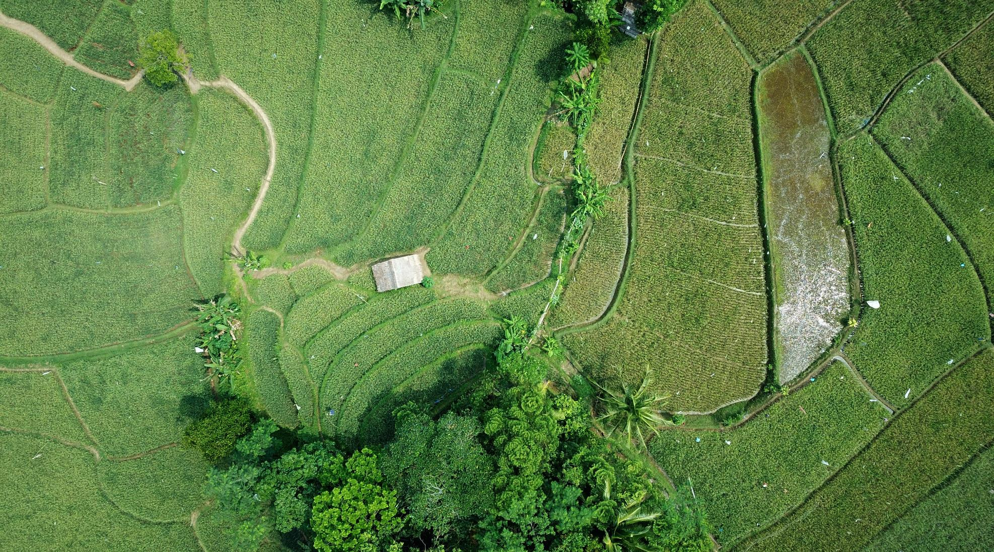
Data Analysis on Effect of weather on online food ordering
By: Benjamin Yen SG-DSI-35

Slide 2
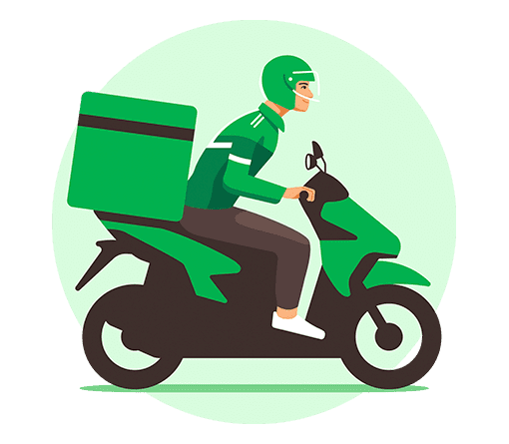
Work for Grab delivery
Who am I?

Slide 3
Problem Statement
Every year, delivery operations and customer demand are heavily impacted by rainy weather conditions.
This can be circumvented if the company can plan for such conditions beforehand.

Slide 4
Project Aim
This project aims to analyze the monthly weather patterns
over the year to allow the operations team to better plan
and allocate resources during the rainy seasons.

Slide 5
Research
Research shows how does the weather influence the types and frequency on online food ordering
Source: Effect of weather on online food ordering DOI: 10.1108/K-05-2020-0322

Slide 6
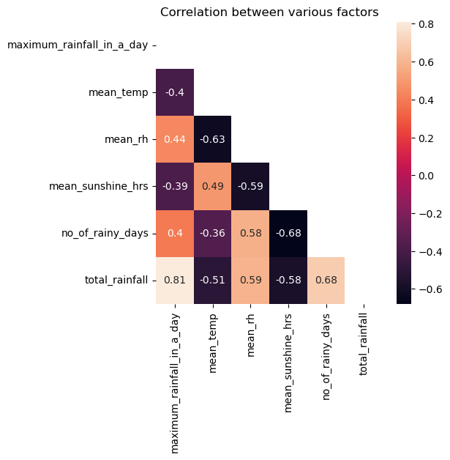
Technical Analysis
This shows a heat map of the correlationship between the variables. This allows us to see which variables has a strong correlation as shown between total rainfall and maximum rainfall in a day which stand at 0.81. However, heat map in general doesn't tell the full story as the points are all condensed into one hence more detailed analysis is needed to determine the comparison of variables.

Slide 7
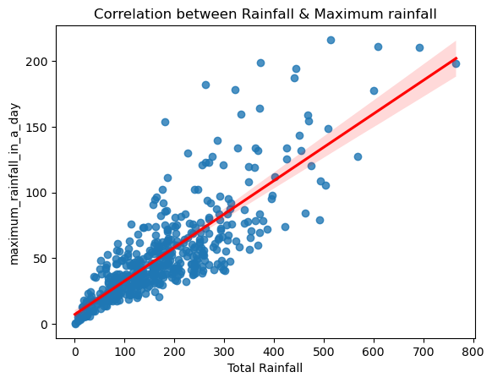
Technical Analysis
As the above heat map shows a strong relationship between total rainfall and maximum rainfall in the day hence I have dive in to see the correlation between the variables. As we can see, there is a strong and direct relationship between both variables.

Slide 8
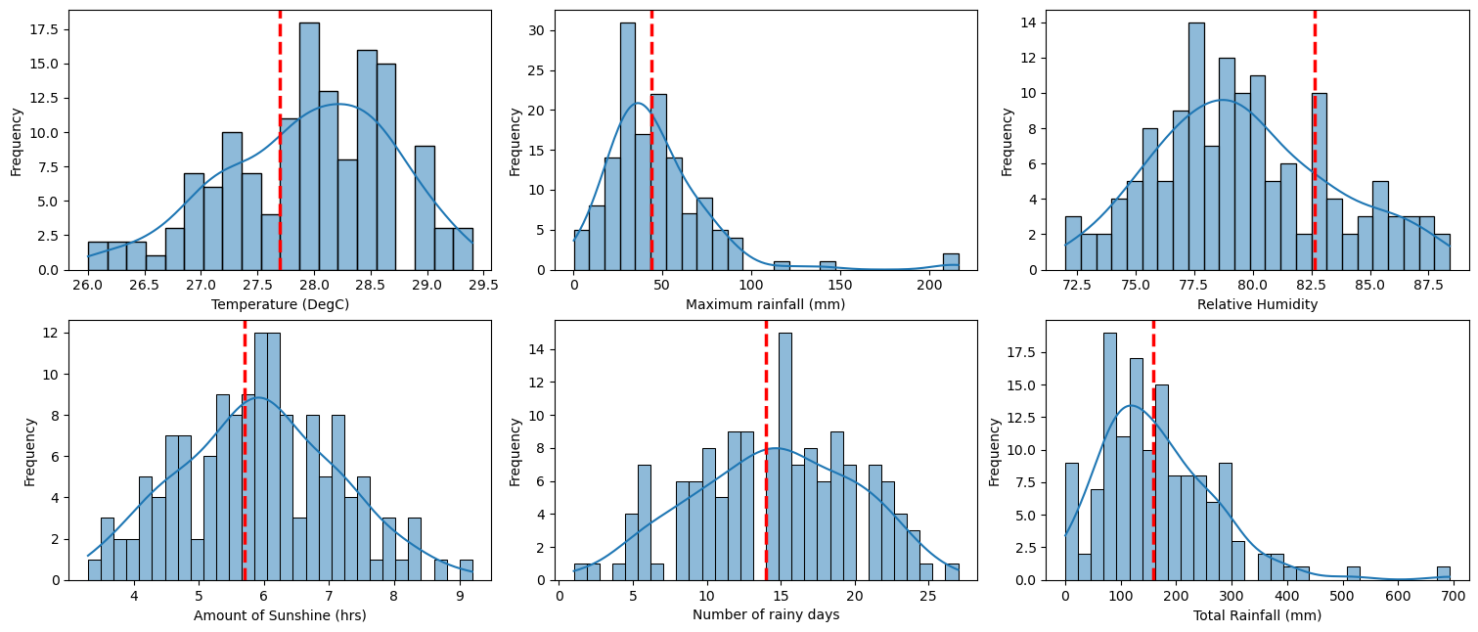
Technical Analysis Histogram Trends

Slide 9
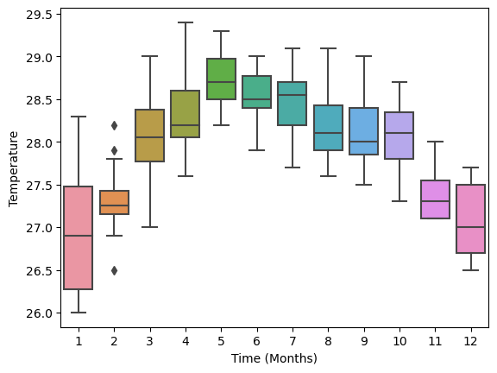
Technical Analysis
We can see the temperature generally are cooler from Nov to Jan due to the seasonal monsoon and as the wet season passes, temperature starts to raise. The hottest period is from Apr to Oct as this period is also considered the dry and hot summer season in Singapore.

Slide 10
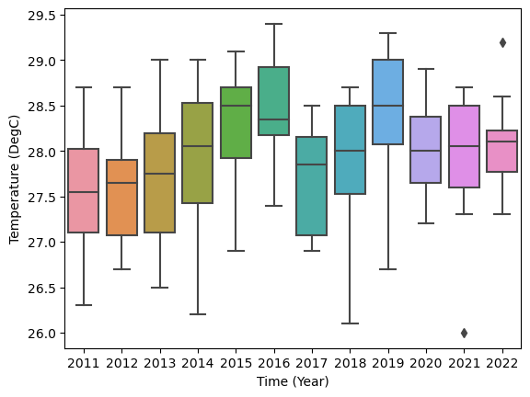
Technical Analysis
This plot is based on the year basis. There is an average between 27 to 29 degC except for 2017 where Singapore experienced drop in temperature as compared to the other years. This was due to the possibility of a weak monsoon surge developing over the South China Sea and surrounding region — which resulted in windy conditions with moderate rain and cooler temperatures.

Slide 11
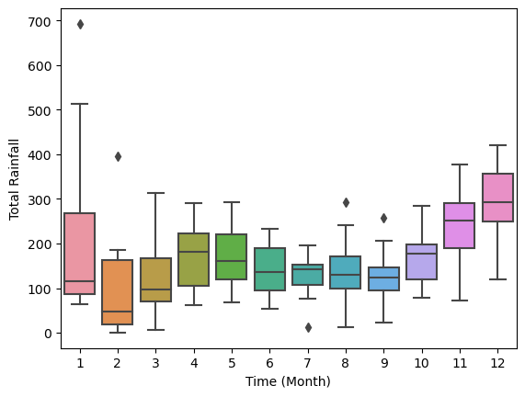
Technical Analysis
This plot shows the monthly total amount of rainfall from 2015 to 2022. Based on the graph, we can see the the rainfall starts to pick up from October until Jan. After which, it drops before stabilizing from March onwards, and the cycle will repeat.

Slide 12
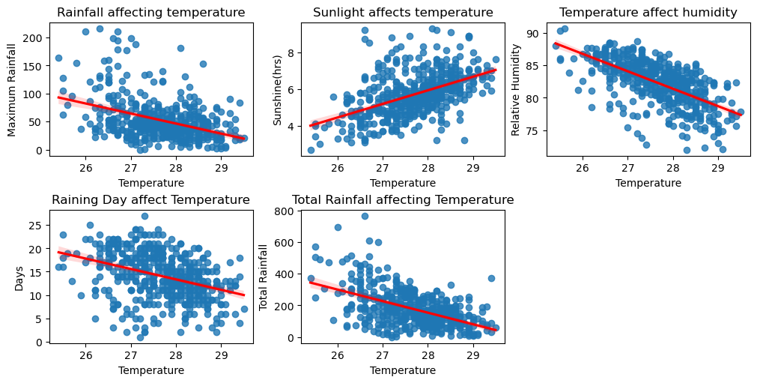
Technical Analysis

Slide 13
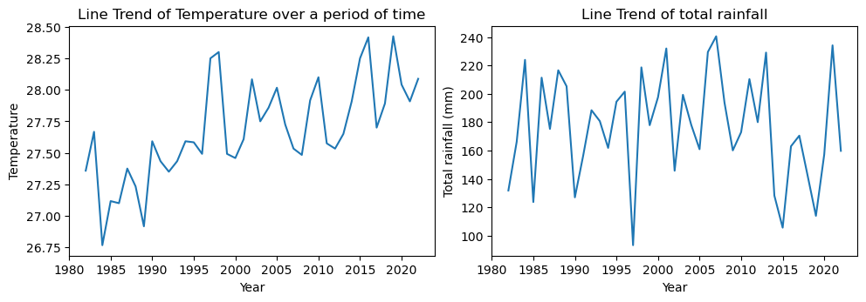
Technical Analysis

Slide 14
Conclusion
Rainfall contribute directly to the temperature which can impact food delivery orders and types of food delivery.
It is found that with warmer temperature, people prefer to eat cold food to regulate body temperature
Poor air quality will increase takeaway orders as people will avoid going out on poor air quality conditions which increase online shopping
It was found that climate change is real as data shows that temperature are steadily increasing throughout the years.

Slide 15
Recommendation
Recommending to have more riders to be available during the peak wet seasons.
With the data showing that the wet season are mainly from Oct – Jan. This correspond with the spending season such as Christmas and New year hence some program incentive should be implemented.
More research to be done to formulate corresponding promotion programs and better to meet consumer demand based on weather plan

Slide 16
THANK YOU

